Slide 1
PROJECT PRESENTATION Customer Retention Case study
Notes:
This template can be used as a starter file to give updates for project milestones.
Sections
Right-click on a slide to add sections. Sections can help to organize your slides or facilitate collaboration between multiple authors.
Notes
Use the Notes section for delivery notes or to provide additional details for the audience. View these notes in Presentation View during your presentation.
Keep in mind the font size (important for accessibility, visibility, videotaping, and online production)
Coordinated colors
Pay particular attention to the graphs, charts, and text boxes.
Consider that attendees will print in black and white or grayscale. Run a test print to make sure your colors work when printed in pure black and white and grayscale.
Graphics, tables, and graphs
Keep it simple: If possible, use consistent, non-distracting styles and colors.
Label all graphs and tables.

Slide 2
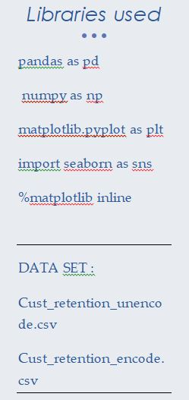
Project Overview
What is the project about?
Define the goal of this project
Data Collection
Notes:
What is the project about?
Define the goal of this project
Is it similar to projects in the past or is it a new effort?
Define the scope of this project
Is it an independent project or is it related to other projects?
* Note that this slide is not necessary for weekly status meetings

Slide 3
What is the project about?
Customer satisfaction has emerged as one of the most important factors that guarantee the success of online store; it has been posited as a key stimulant of purchase, repurchase intentions and customer loyalty. A comprehensive review of the literature, theories and models have been carried out to propose the models for customer activation and customer retention. Five major factors that contributed to the success of an e-commerce store have been identified as: service quality, system quality, information quality, trust and net benefit. The research furthermore investigated the factors that influence the online customers repeat purchase intention. The combination of both utilitarian value and hedonistic values are needed to affect the repeat purchase intention (loyalty) positively. The data is collected from the Indian online shoppers. Results indicate the e-retail success factors, which are very much critical for customer satisfaction.

Slide 4
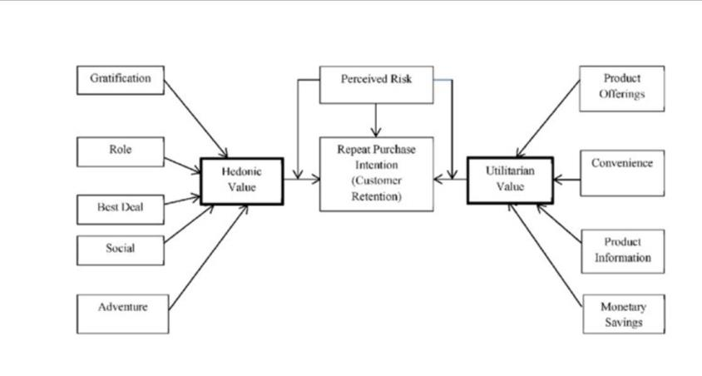
Define the goal of this project

Slide 5
* This dataset comprises of respondents from online shoppers , they have shared their shopping experience.
* Using the combined responses of their experience we are going to see the utilitarian as well as the hedonistic value weightage.
* Since we do not have a target variable we will assume that the higher values in both the utilitarian as well as the hedonistic value and feature which compliments that will increase customer retention
* We will also find out which group of the respondents fall into the category of having highest customer retention

Slide 6
DATA COLLECTION
We have 2 datasets where one has encoded variables while the other has un coded , we will try to use both in our analysis
The Dataset is collected from online shoppers by them filling out the form which shows their online shopping experience
The data consists of 71 column and 269 rows.

Slide 7
Check the names of the columns The Users characteristics 1-17
1Gender of respondent', '2 How old are you? ', '3 Which city do you shop online from?', '4 What is the Pin Code of where you shop online from?', '5 Since How Long You are Shopping Online ?', '6 How many times you have made an online purchase in the past 1 year?', '7 How do you access the internet while shopping on-line?', '8 Which device do you use to access the online shopping?', '9 What is the screen size of your mobile device?\t\t\t\t\t\t ', '10 What is the operating system (OS) of your device?\t\t\t\t ', '11 What browser do you run on your device to access the website?\t\t\t ', '12 Which channel did you follow to arrive at your favorite online store for the first time? ', '13 After first visit, how do you reach the online retail store?\t\t\t\t ', '14 How much time do you explore the e- retail store before making a purchase decision? ', '15 What is your preferred payment Option?\t\t\t\t\t ', '16 How 4 do you abandon (selecting an items and leaving without making payment) your shopping cart?\t\t\t\t\t\t\t ', '17 Why did you abandon the Bag, Shopping Cart?\t\t\t\t\t ',
Notes:
* If any of these issues caused a schedule delay or need to be discussed further, include details in next slide.

Slide 8
Columns asking their rating based on online shopping 18-38
'18 The content on the website must be easy to read and understand', '19 Information on similar product to the one highlighted is important for product comparison', '20 Complete information on listed seller and product being offered is important for purchase decision.', '21 All relevant information on listed products must be stated clearly', '22 Ease of navigation in website', '23 Loading and processing speed', '24 User friendly Interface of the website', '25 Convenient Payment methods', '26 Trust that the online retail store will fulfill its part of the transaction at the stipulated time', '27 Empathy (readiness to assist with queries) towards the customers', '28 Being able to guarantee the privacy of the customer', '29 Responsiveness, availability of several communication channels (email, online rep, twitter, phone etc.)', '30 Online shopping gives monetary benefit and discounts', '31 Enjoyment is derived from shopping online', '32 Shopping online is convenient and flexible', '33 Return and replacement policy of the e-tailer is important for purchase decision', '34 Gaining access to loyalty programs is a benefit of shopping online', '35 Displaying quality Information on the website improves satisfaction of customers', '36 User derive satisfaction while shopping on a good quality website or application', '37 Net Benefit derived from shopping online can lead to users satisfaction', '38 User satisfaction cannot exist without trust',

Slide 9
Contd:-
'39 Offering a wide variety of listed product in several category', '40 Provision of complete and relevant product information', '41 Monetary savings', '42 The Convenience of patronizing the online retailer', '43 Shopping on the website gives you the sense of adventure', '44 Shopping on your preferred e-tailer enhances your social status', '45 You feel gratification shopping on your favorite e-tailer', '46 Shopping on the website helps you fulfill certain roles', '47 Getting value for money spent', 'From the following, tick any (or all) of the online retailers you have shopped from; ', 'Easy to use website or application', 'Visual appealing web-page layout', 'Wild variety of product on offer', 'Complete, relevant description information of products', 'Fast loading website speed of website and application', 'Reliability of the website or application', 'Quickness to complete purchase', 'Availability of several payment options', 'Speedy order delivery ', 'Privacy of customers information', 'Security of customer financial information', 'Perceived Trustworthiness', 'Presence of online assistance through multi-channel', 'Longer time to get logged in (promotion, sales period)', 'Longer time in displaying graphics and photos (promotion, sales period)', 'Late declaration of price (promotion, sales period)', 'Longer page loading time (promotion, sales period)', 'Limited mode of payment on most products (promotion, sales period)', 'Longer delivery period', 'Change in website/Application design', 'Frequent disruption when moving from one page to another', 'Website is as efficient as before', 'Which of the Indian online retailer would you recommend to a friend?

Slide 10
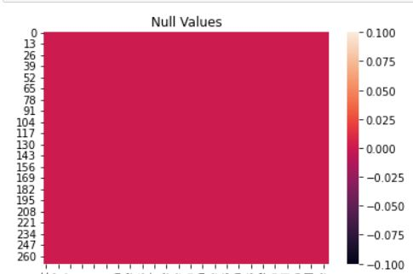
Checking for null values
As per the output from df.null.sum as well as ,info we see that there are 0 null’s
We see from the diagram as well that there are no null values

Slide 11
Types of data in the set
We have 46 numerical features
We have 25 categorical features

Slide 12
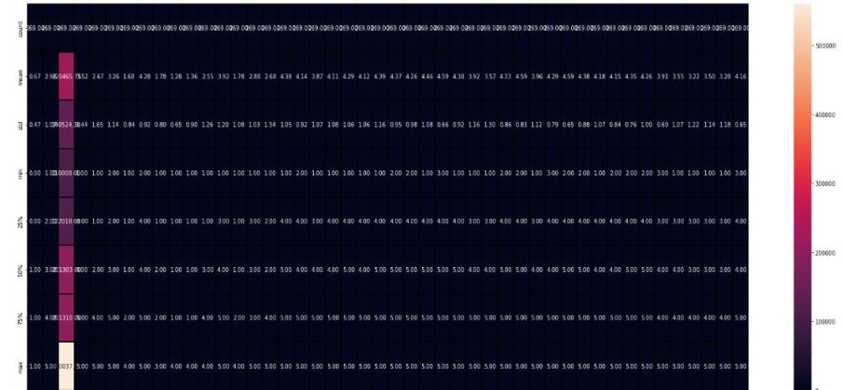
Using ‘Describe’ to show information of a numerical columns

Slide 13
Observations
We see that the columns which are not asking for user characteristics and rating based have data btw 1-5 ,
We see that all the ratings columns have highest as 5 and lowest 15 as well .
We see that the values in the graph fall within 0 to 10000 which is not good

Slide 14
Printing all the unique values within each column
*Columns which have numeric values are in range of 1 to 5 , Most of them are ratings for questions based on the type of common feature in online shopping
*5 is the highest while 1 is the lowest and 3 is indifferent which means they are not against it or for it
Observations made :-¶
*Columns which have numeric values are in range of 1 to 5 , Most of them are ratings for questions based on the type of common feature in online shopping
*5 is the highest while 1 is the lowest and 3 is indifferent which means they are not against it or for it

Slide 15
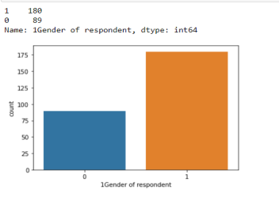
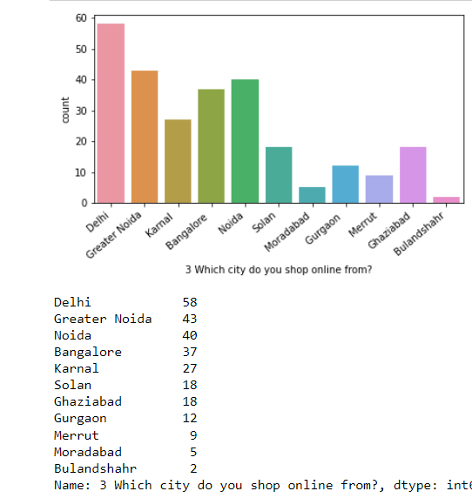
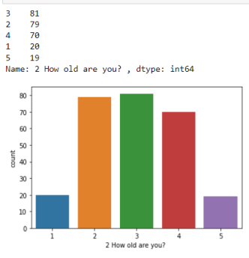
Visualization of the Data Count plot and total counts of each column

Slide 16
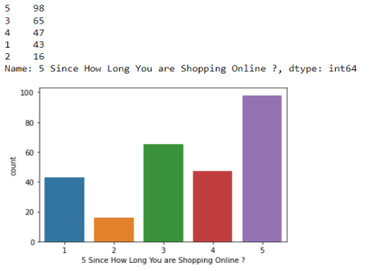
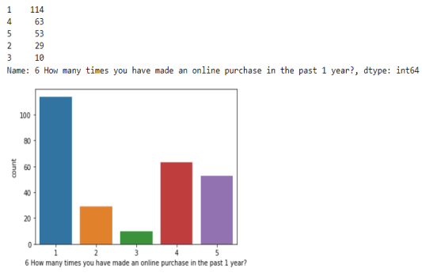
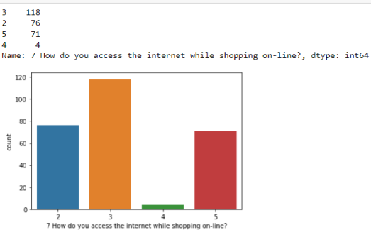
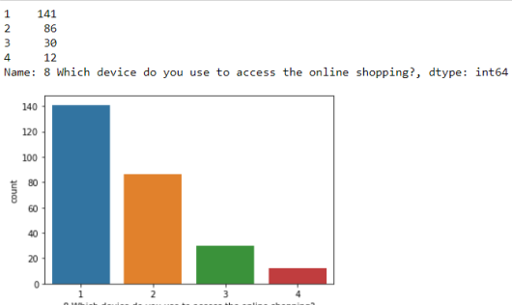

Slide 17
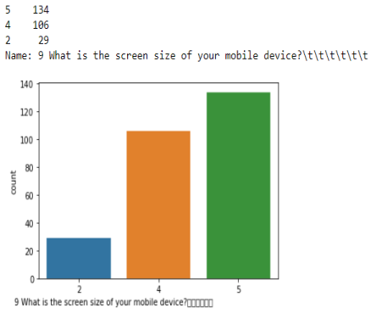
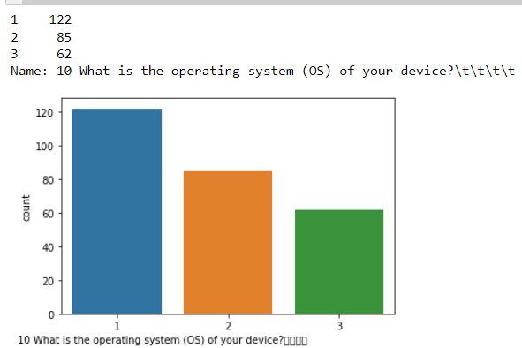
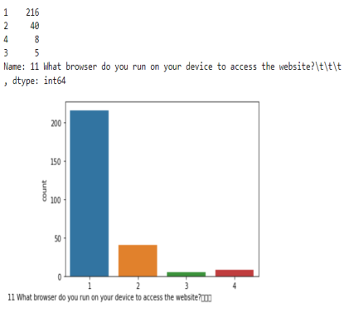
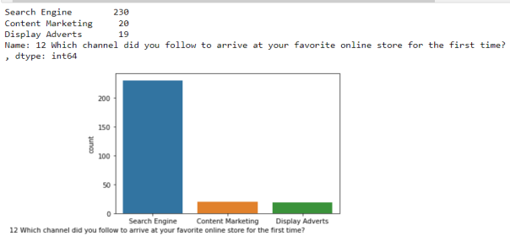

Slide 18
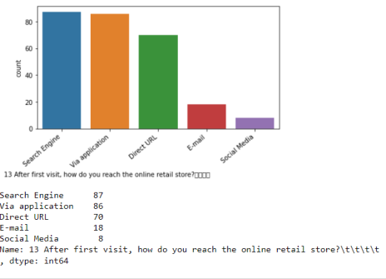
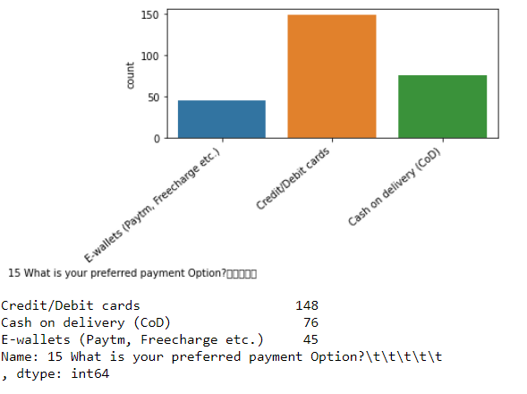
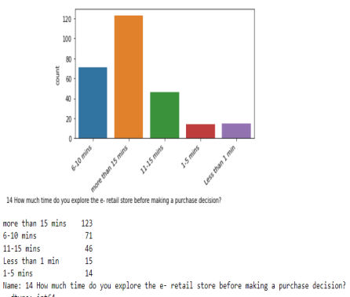
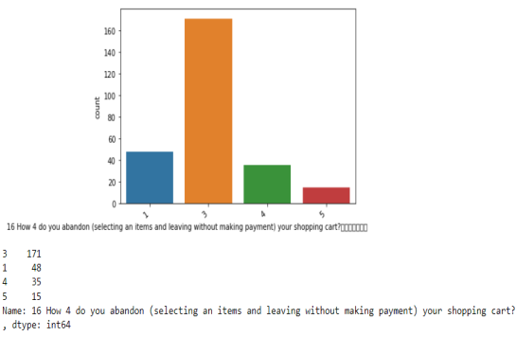

Slide 19
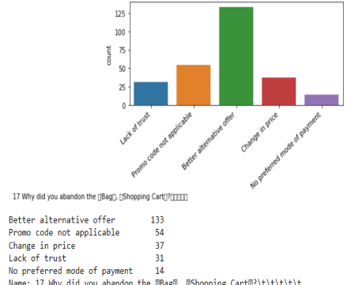
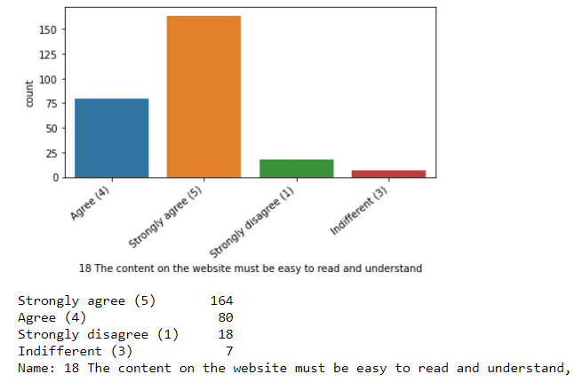
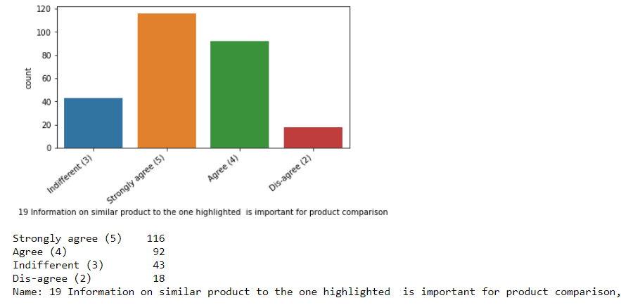
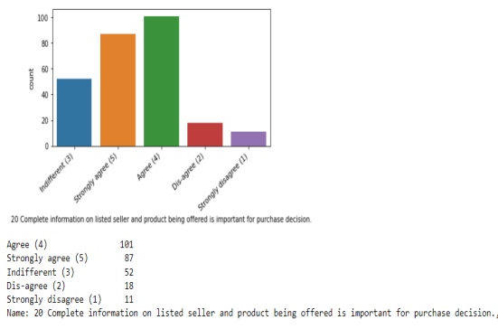

Slide 20
OBSERVATIONS
With col 1 to 17 as they are user features
We see the max of users are females
We see that people between 21 to 40 are the highest age group
We see most of user are from Delhi
Most of the users have been shopping online for more than 4 years
And they have purchased more than 10 times in the past 1 year
Most users have mobile internet to use the online shopping platform
Most users are iphone or Mac users
Most users have 5.5 inches or more devices
Majority of users use google chrome
Most of the users use search engine to arrive at the product or platform website
Most reach the product page and also the app page after the search
Most spend more than 15 min in page
Most pay with debit or credit card

Slide 21
After checking user features we move to actions on page
We see most leave the page after checkout sometimes
We see they find better offer s they abandon
Then rating columns begin(we will touch on most but as we see they all are choosing that all the features are very important for customer retention the highest value in each category
18 The content on the website must be easy to read and understand
Strongly agree (5) 164
19 Information on similar product to the one highlighted is important for product comparison
Strongly agree (5) 116
20 Complete information on listed seller and product being offered is important for purchase decision
Agree (4) 101
21 All relevant information on listed products must be stated clearly -Agree (4) 132
22 Ease of navigation in website Strongly agree (5) 141
23 Loading and processing speed Strongly agree (5) 115
24 User friendly Interface of the website Strongly agree (5) 189
25 Convenient Payment methodsStrongly agree (5) 159
26 Trust that the online retail store will fulfill its part of the transaction at the stipulated timeStrongly agree (5) 141

Slide 22
28 Being able to guarantee the privacy of the customerStrongly agree (5) 185
29 Responsiveness, availability of several communication channels (email, online rep, twitter, phone etc.)Strongly agree (5) 149

Slide 23
Rest of the rating features
30 Online shopping gives monetary benefit and discounts Strongly agree (5) 105
31 Enjoyment is derived from shopping onlineStrongly agree (5) 86
32 Shopping online is convenient and flexibleStrongly agree (5) 146
28 Being able to guarantee the privacy of the customerStrongly agree (5) 185
34 Gaining access to loyalty programs is a benefit of shopping onlineStrongly agree (5) 115
35 Displaying quality Information on the website improves satisfaction of customersStrongly agree (5) 133
36 User derive satisfaction while shopping on a good quality website or applicationStrongly agree (5) 175
37 Net Benefit derived from shopping online can lead to users satisfactionStrongly agree (5) 164
38 User satisfaction cannot exist without trustStrongly agree (5) 122
39 Offering a wide variety of listed product in several categoryStrongly agree (5) 111
40 Provision of complete and relevant product informationStrongly agree (5) 135
41 Monetary savingsStrongly agree (5) 148

Slide 24
We see that most of the users have chosen strong agree or Agree for all the features
We also see that the vast majority of the users shop more than 4 years so we have a mix of both young adults and adults .
Let us move to only the ratings columns and their total value

Slide 25
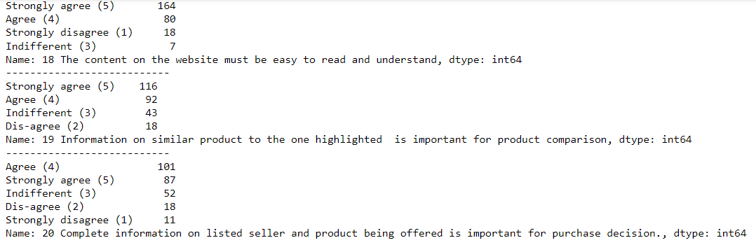

Slide 26
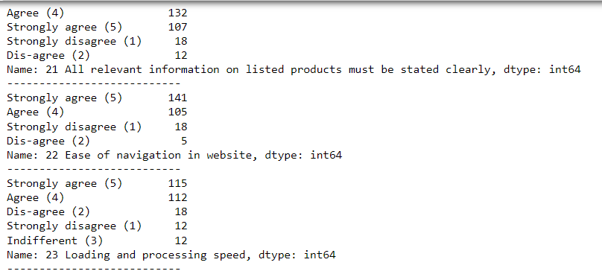

Slide 27
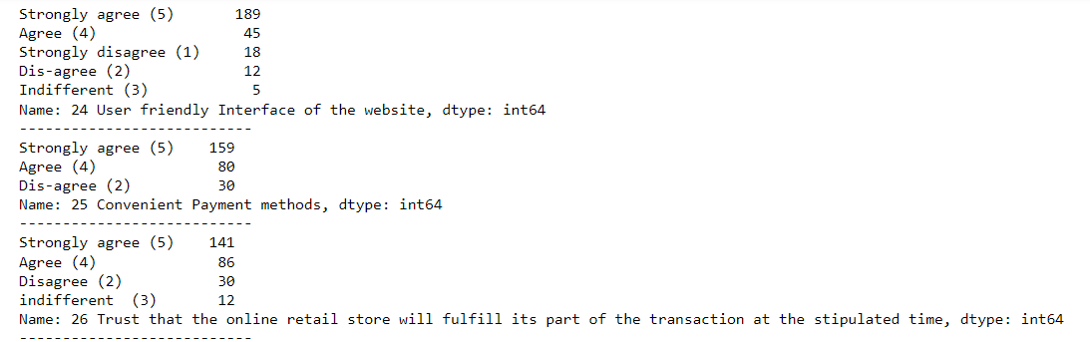

Slide 28
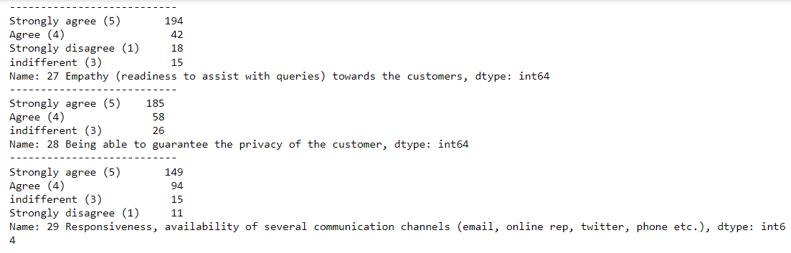

Slide 29
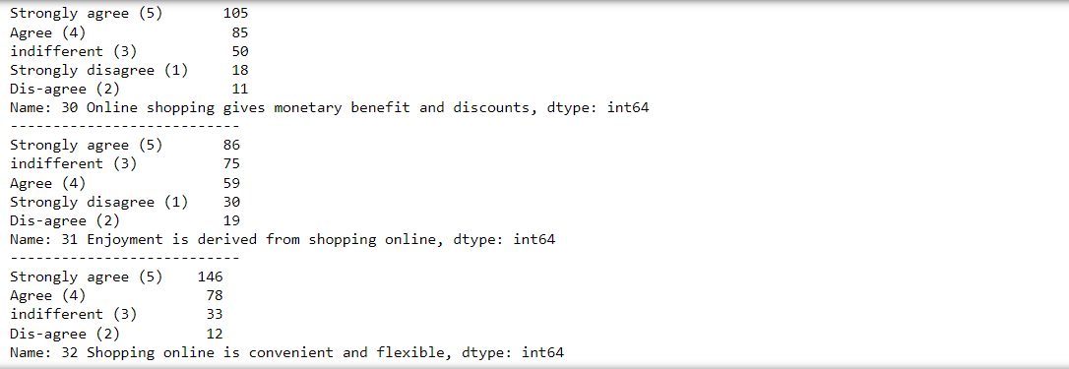

Slide 30
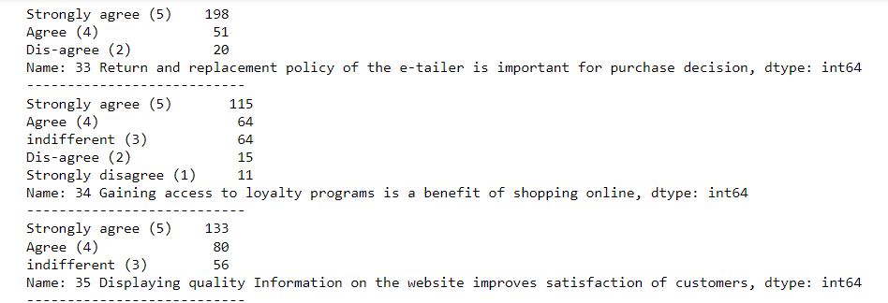

Slide 31
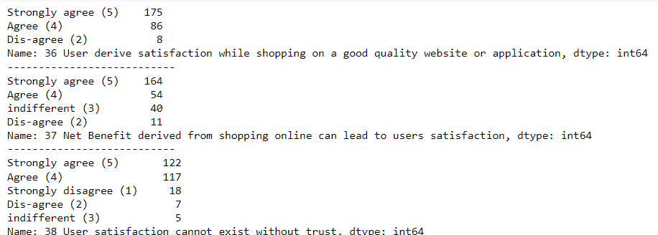

Slide 32
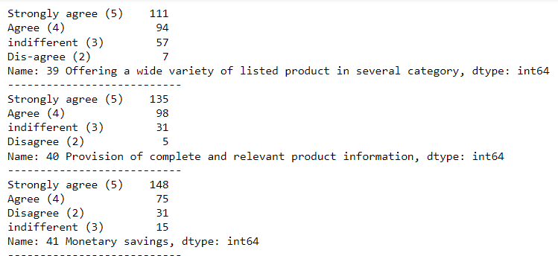

Slide 33
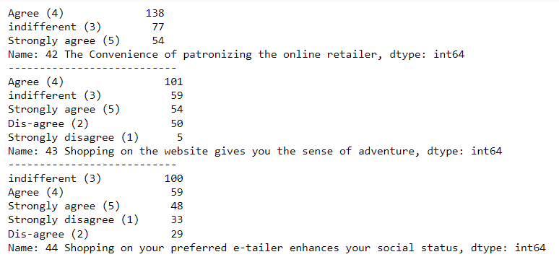

Slide 34
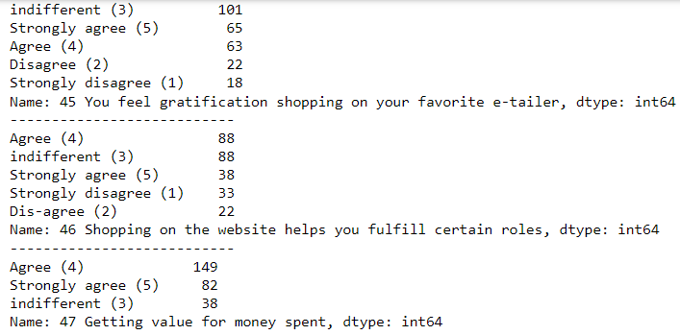

Slide 35
Correlation between the features
We check for the values in a tabular columns first , as there are too many columns,
We will also plot a heat map to see the relationship
We see that some columns are high ly correlated will check them out

Slide 36
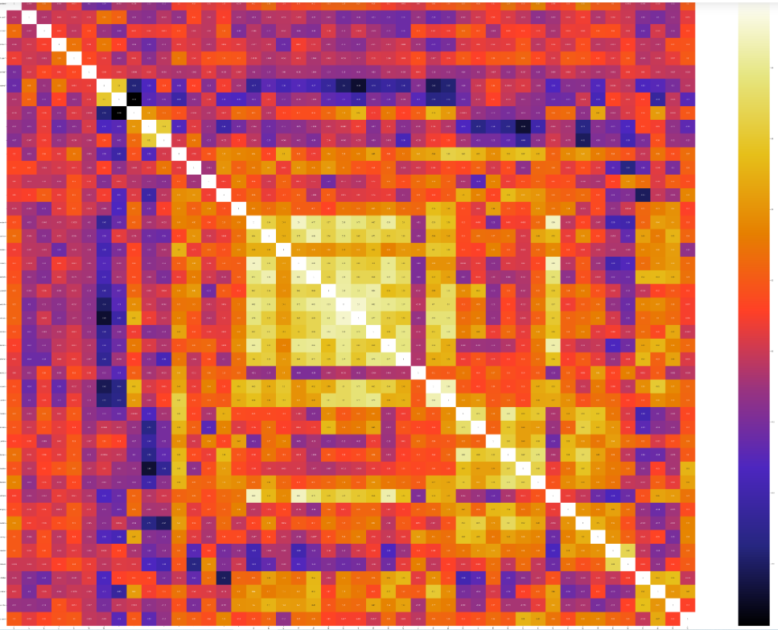

Slide 37
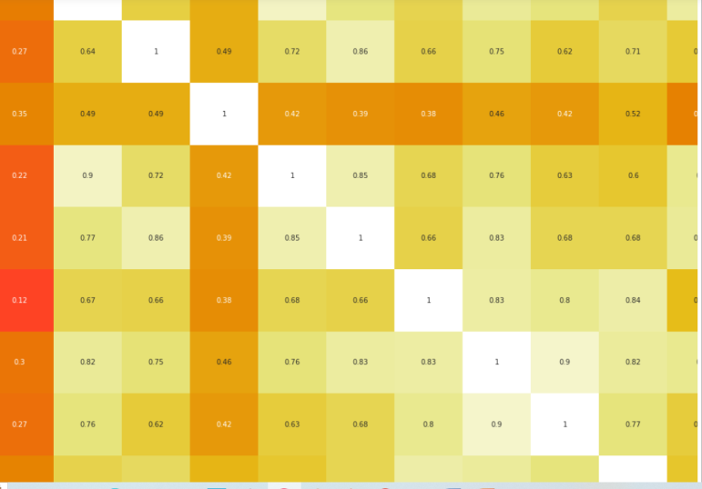
We see that there is a significant amount of columns whose relationship between themis very high

Slide 38
We see that the features from 18th to 47 as shows very high correlation with the other features as they all show that users fee all the features are very important to improve customer retention

Slide 39
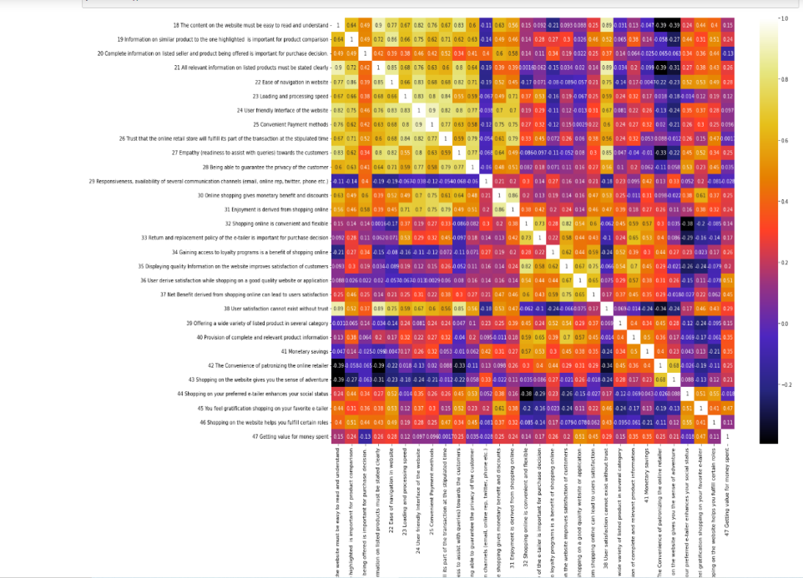

Slide 40
In the previous slide we only check for relationship btw the ratings columns,
We see there is high correlation between the columns 18 to 28 as well as 33 to 37th columns .
We see that the features all state that the values are stating there is strong +ve relationship that all the features are very important to retain customers in the platform

Slide 41
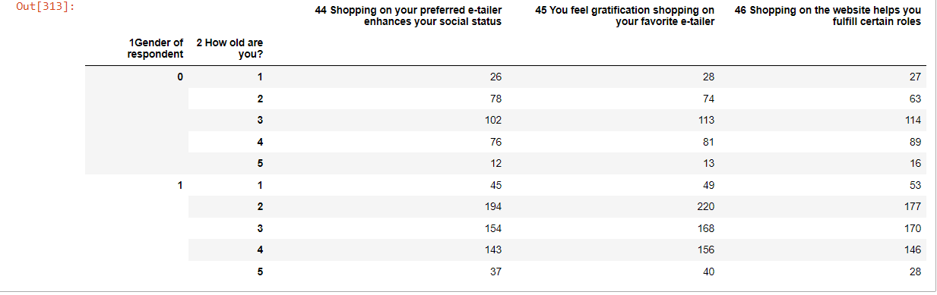
We are plotting pivot table to check the spread of the rating columns and among the features of the user characteristics

Slide 42
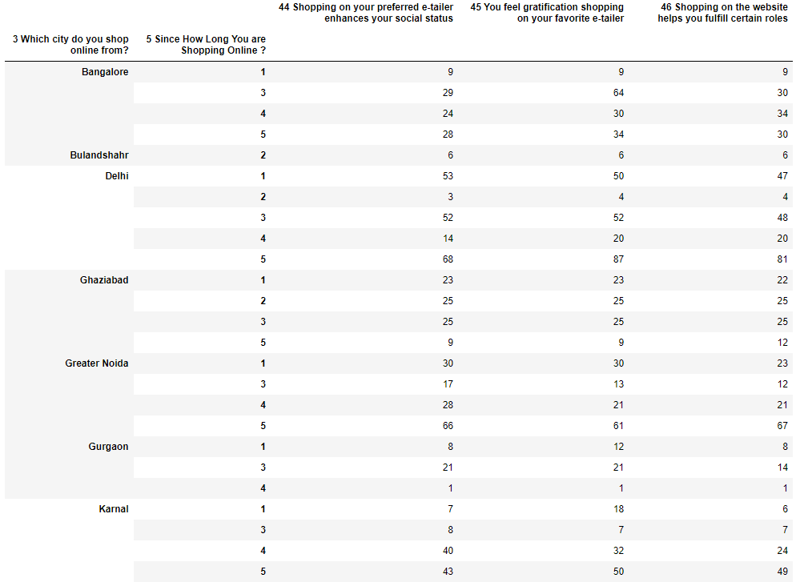

Slide 43
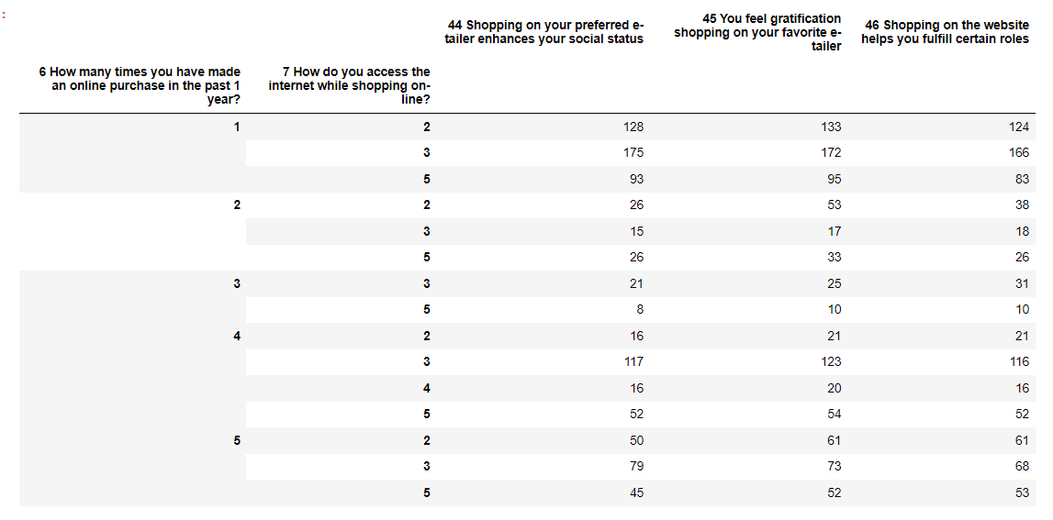

Slide 44
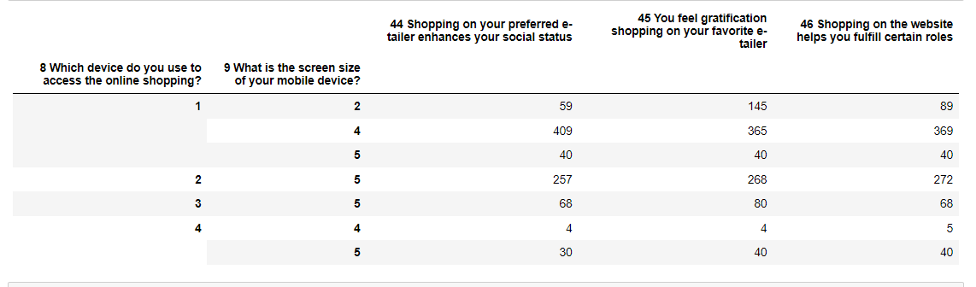

Slide 45
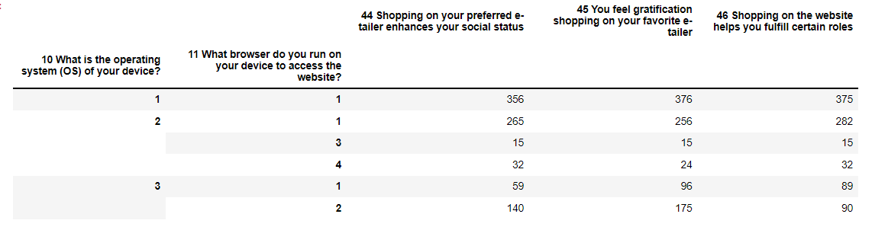

Slide 46
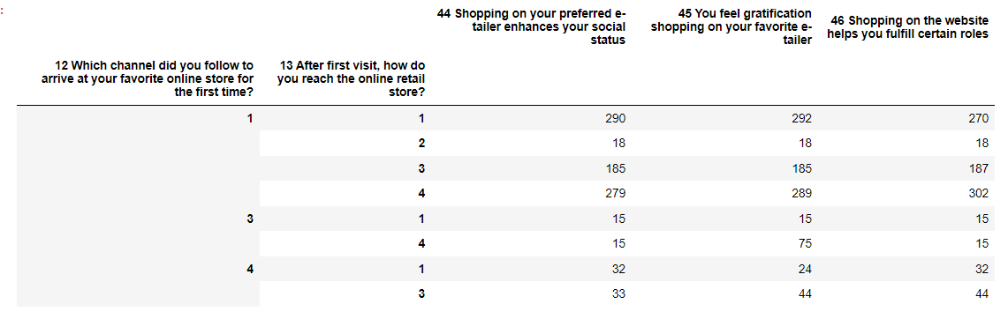

Slide 47
Plotting Dist Plot for rating columns
We see that the most importance or max of the users chose that they strongly agree that all the features are important.
We see that both the utilitarian as well as the hedonistic values for the online shopping experience is very important as per this dataset

Slide 48
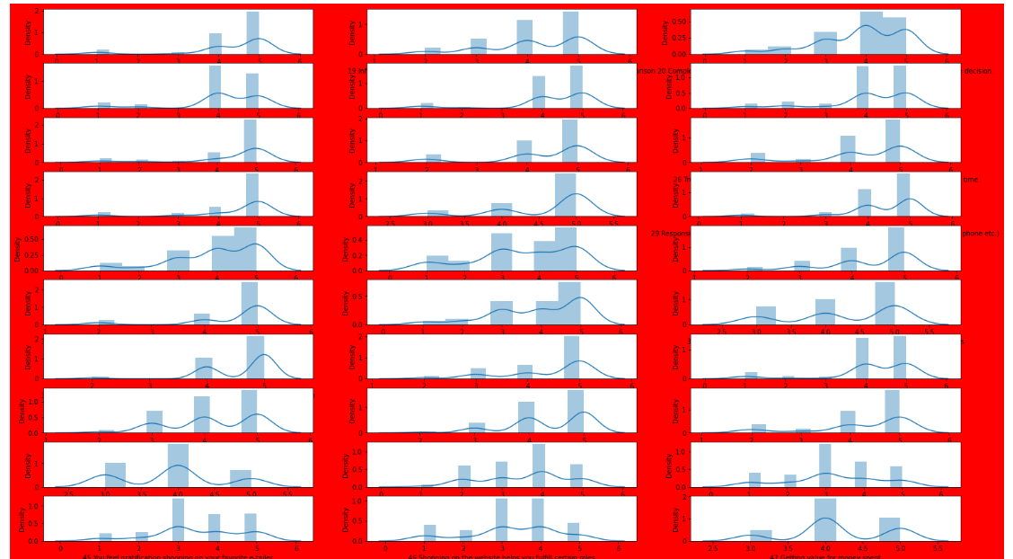

Slide 49
We see that all the columns show data is beyond 4 and 5 which means that most of the user are strongly agreeing that all the features are important for customer retention.
We also don’t see outliers as the columns have categorical data.

Slide 50
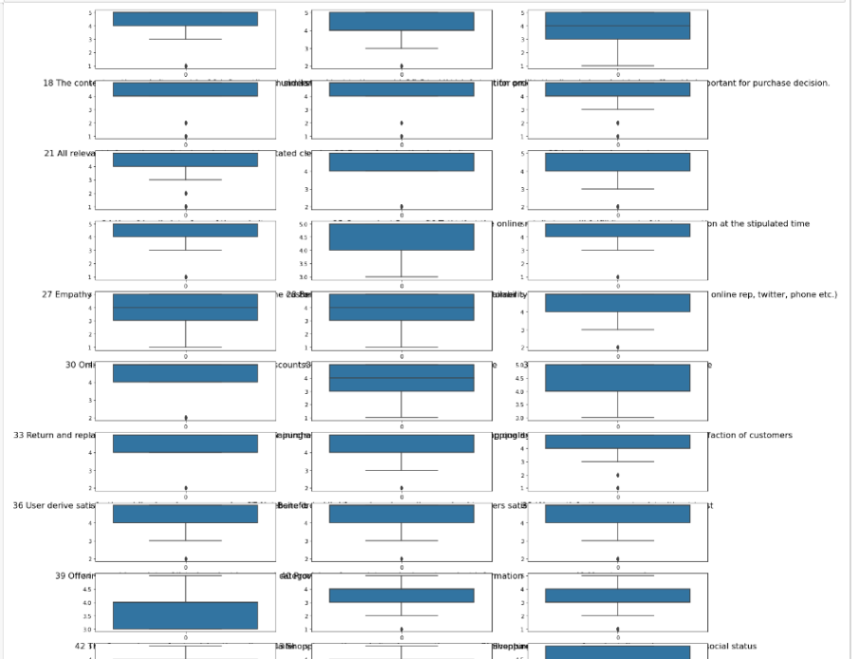

Slide 51
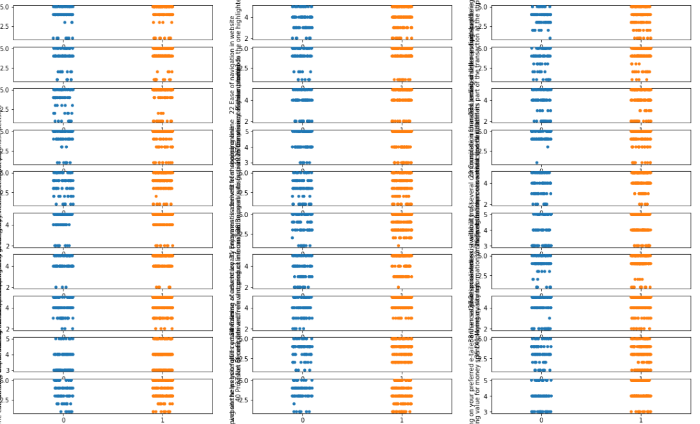

Slide 52
Conclusion:-
We have done Exploratory Data Analysis , In our analysis we have seen -
* There are 71 columns and 269 rows of data.
* We have seen that the values from 1 to 17 shows the characteristics of the user or respondents
* we see that the columns 18 to 47 show rating of the features of the online shopping experience.
* We see that the rest columns form 48 to 71 show the similar features of the user experience
* we have plotted countplot,barplot,stripplot,boxplot
* we have done correlation matrix with the whole data as well as the ratings columns alone
* we did feature engineering by checking nulls as well as making separate objects for rating and non numeric col
* we have plotted pivot table to check the relationship btw the user characteristics as well as the rating columns
We see that from our analysis the maximum no of users feel that all the features are very important in their online experience, Be it Utilitarian value and hedonistic , all of them selected strongly agrre for the features importance.

